Slide 1
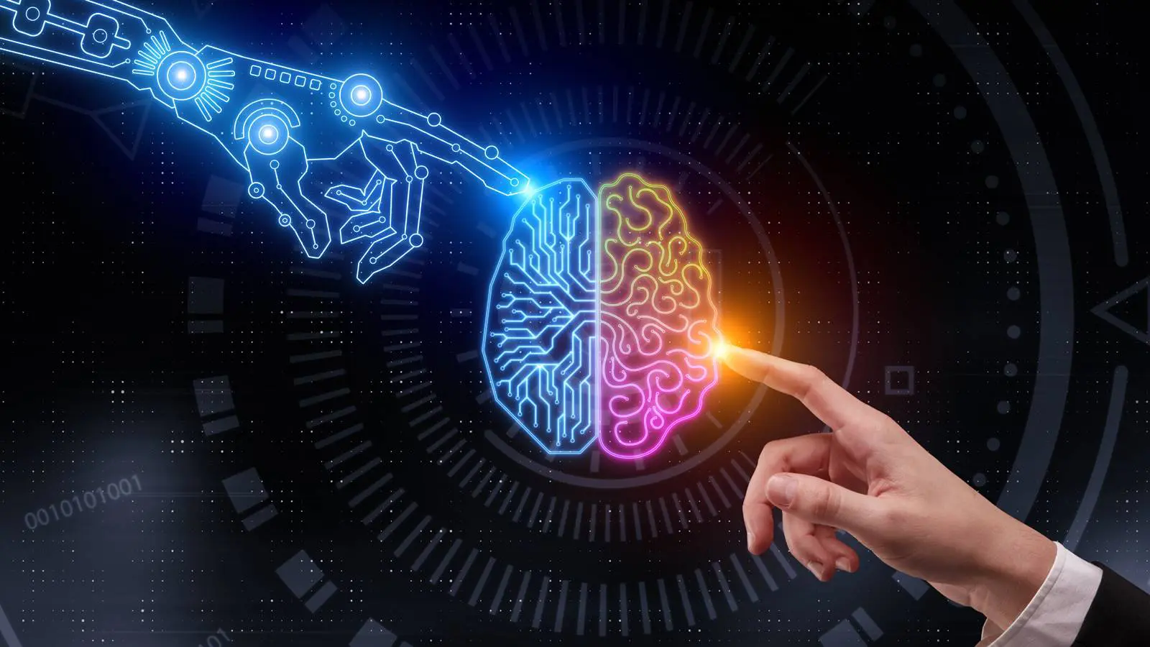
Artificial
Intelligence
04/09/25
Bria Miles

Slide 2
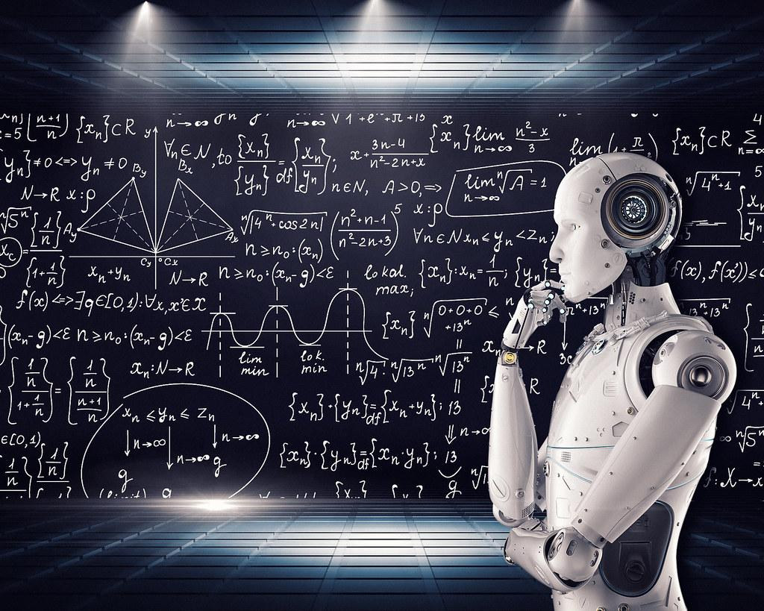
Introduction
What is Artificial Intelligence?
AI is the simulation of human intelligence in machines that can learn, reason, and perform tasks autonomously.
Why is Artificial Intelligence Important?
AI enhances efficiency, automates tasks, and can be used to solve complex problems in many different fields.

Slide 3
Topics Covered
01
History of AI
02
How AI Works
03
Types and Applications of AI
04
Ethical Concerns and Future Trends

Slide 4
History of AI
1950’s
1960’s - 70’s
1980’s - 90’s
2000’s - Present
1950: Alan Turing published “Computer Machinery and Intelligence” which proposed a test of machine intelligence
1955: The term “Artificial Intelligence” was coined at a Dartmouth Conference by John McCarthy
A period of rapid growth but struggle for AI research.
- first ELIZA chatbot
- first anthropomorphic robot built in Japan
- first example of an autonomous vehicle
- US government showed little interest in continuous funding
A period of growth and interest in AI
- additional government funding
- Machine learning gained traction
- AI applications grew in industries
- introduction of the first AI system that could beat a world champion chess player
- soon introduced AI into everyday life
- first commercially available speech recognition software on Windows computers
- ChatGPT
- autonomous cars
- AI powered technologies still advancing rapidly
Strategic
budgeting
Strategic
budgeting
Strategic
budgeting
Strategic
budgeting
Decrease avg time-to-hire by 20%. Achieve 50% participation in leadership program.
Decrease avg time-to-hire by 20%. Achieve 50% participation in leadership program.
Decrease avg time-to-hire by 20%. Achieve 50% participation in leadership program.
Decrease avg time-to-hire by 20%. Achieve 50% participation in leadership program.
XX
XX
XX
XX

Slide 5
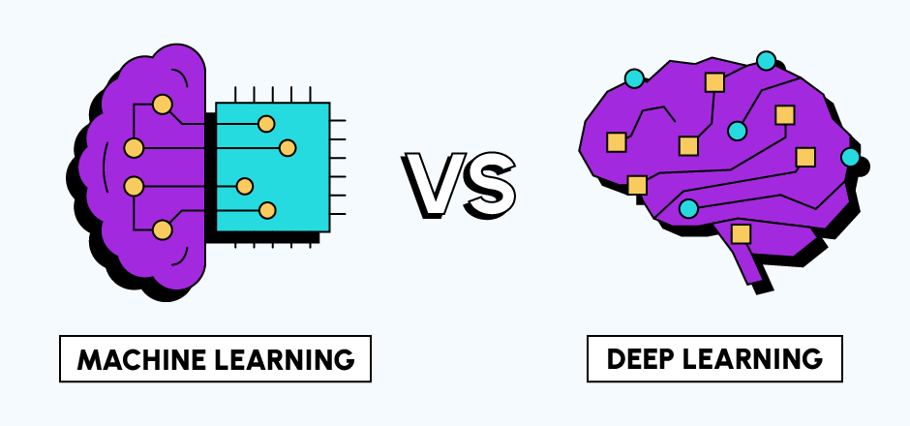
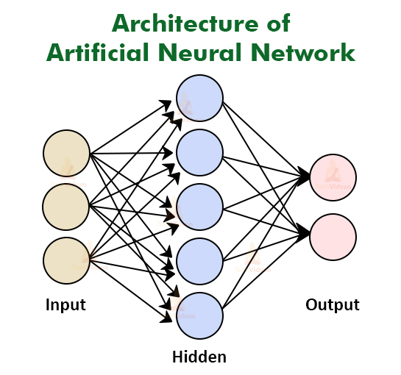
How AI Works
Artificial Intelligence works by simulating human intelligence through the use of algorithms, data, and computational power.
Key AI Techniques:
Machine learning: AI learns patterns from data without explicit programming
Deep Learning: AI uses multi-layered neural networks to analyze complex data
Neural Networks: Modeled after the human brain, used in image and speech recognition
Big Data & AI: AI processes vast amounts of information to improved decision making

Slide 6
Types of AI
Narrow AI
General AI
Super AI
(Weak AI)
(Strong AI)
AI designed for specific tasks, such as Google Search, Siri, Amazon’s Alexa, etc.
AI with human-like intelligence that can perform any intellectual task (not yet achieved).
Hypothetical AI that surpasses human intelligence (theoretical and debated).

Slide 7
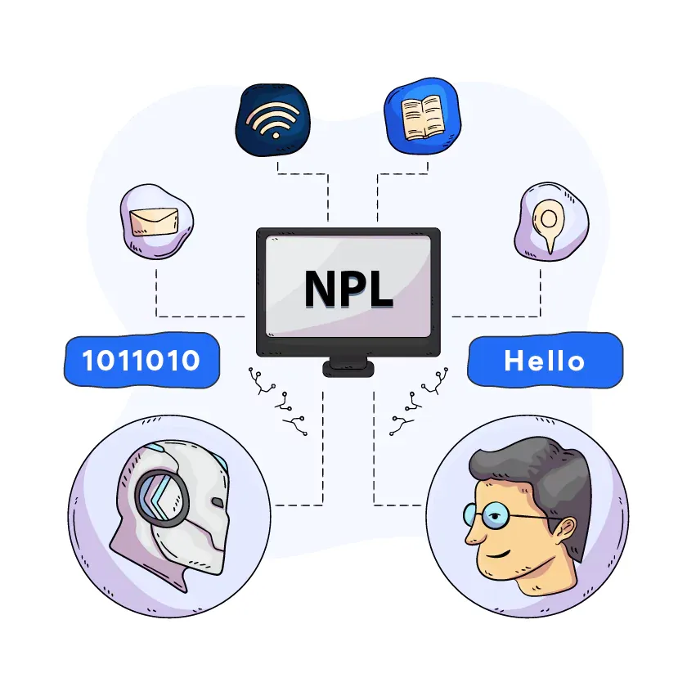
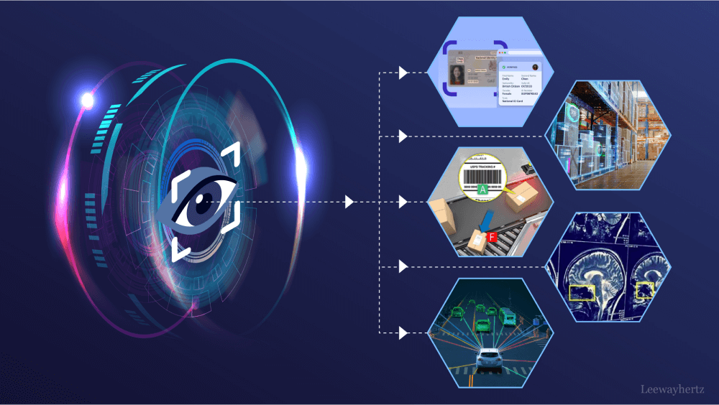
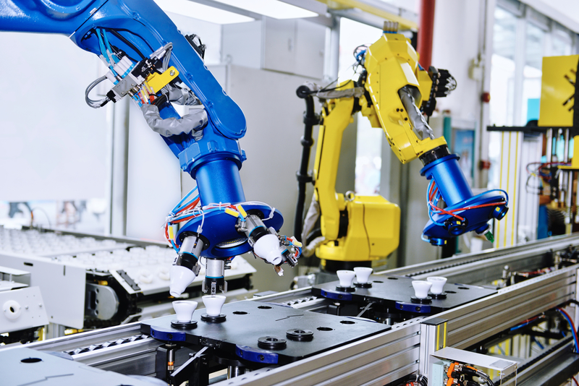
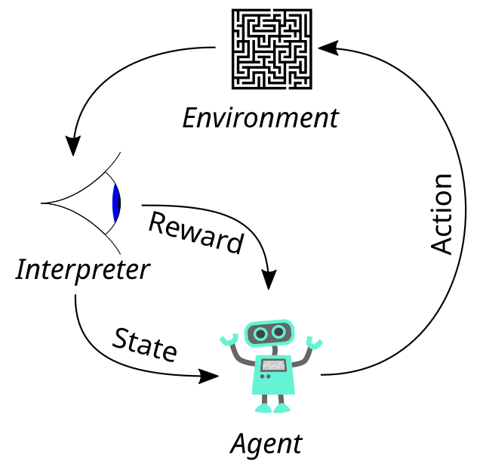
AI Technologies & Techniques
Natural Language Processing
Computer Vision
Robotics & Automation
Reinforcement Learning
AI interprets images/videos (facial recognition, self driving cars, etc)
AI driven robots perform tasks in manufacturing, healthcare, and space exploration.
AI learns by trial and error (AlphaGo, AI powered games, etc.)
AI understands and generated human language (ChatGPT, Google Translate, etc)

Slide 8
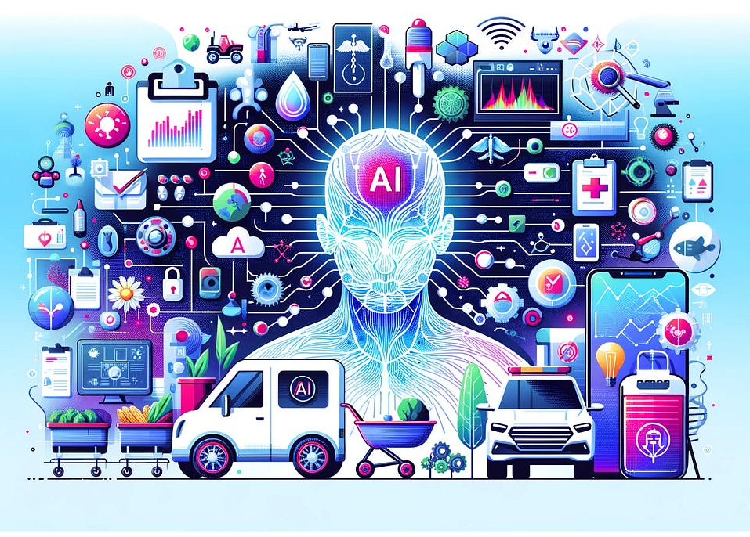
Real World AI Applications
Healthcare
- AI assisted diagnosis, robotic surgery, and drug discovery
Finance
- AI for fraud detection, stock market predictions, and automated trading
Transportation
- Self driving technology from many different companies
- AI can analyze real time traffic data
Customer Service
- AI powered chatbots provide 24/7 customer support
- AI powered virtual assistants (Alexa, Siri, Google Assistant)

Slide 9
Ethical and Social Challenges of AI
Bias and Discrimination
Privacy Concerns
- AI systems can inherit biases from the data they are trained on, leading to discriminatory outcomes
- Facial recognition systems have been found to be less accurate for people with darker skin tones (potential unequal treatment)
- AI relies on large amounts of personal data, raising concerns about data security and misuse
- risk that AI powered surveillance or data tracking could be used without personal consent
Job Displacement
Accountability and Security
- AI systems may make independent decisions, raising questions about accountability in case of errors.
- AI systems are vulnerable to hacking and manipulation, posing cybersecurity risks
- AI automation is replacing certain jobs, leading to unemployment risks in various industries
- could result in economic inequality and disruption

Slide 10
Rise of Ethical AI Frameworks and Patents
As AI becomes more advanced, ensuring human oversight is crucial to prevent unwanted consequences
Has been a growing trend in AI patents focusing on ethical AI development
Organizations and governments are creating frameworks to ensure AI transparency, fairness, and responsibility
Important ethical AI initiatives:
IEEE Global Initiative on Ethics of Autonomous and Intelligent Systems
European Union’s Ethics Guidelines for Trustworthy AI

Slide 11
Environmental Impacts of AI
Increased Energy and Water Consumption
Development and deployment of AI requires large scale computing power, leading to higher electricity consumption
AI data centers use massive amounts of water for cooling, increasing environmental strain
Climate Change Concerns
AI could increase carbon emissions by up to 80%, significantly impacting sustainability efforts
Training of large AI models requires energy intensive operations, often powered by non-renewable resources
Potential for Sustainability
Tech industries face a dilemma: AI can drive sustainability solutions while also worsening environmental harm

Slide 12
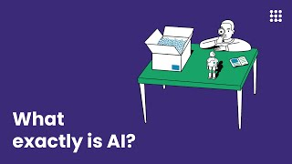
Summary Video

Slide 13
MIT News
Princeton Review
Links Used Throughout my Presentation!
AI History
EDI Weekly
ManagingIP
Future of AI
UIC

Slide 14
↘
Thank You For Listening!

